Slide 1

Streaming Data Analytics
Saptarshi Pyne Assistant Professor Department of Computer Science and Engineering Indian Institute of Technology Jodhpur, Rajasthan, India 342030
CSL4030 Data Engineering Lecture 36
November 15th, 2023

Slide 2
What we discussed in the last class
Query optimization We learnt various techniques for
Enumerating all possible query evaluation plans
Estimating the cost of each plan
Choosing an optimal or approximately optimal plan

Slide 3
What is streaming data?
Data that is continuously being generated (streamed).
Examples:
Click-through data (e.g., for Google search, every page request made by any user anywhere)
Financial trading data
E-commerce transactions
Live streams and broadcasts (sports, online gaming, vlogs, podcasts, election coverage, reporting wars, disasters, pandemics, etc.)
Leaderboards and ‘relative’ leaderboards (gaming apps and gamified apps)

Slide 4
What is streaming data? (contd.)
Examples: (contd.)
Sensor data: seismometers, tsunami warning sensors, etc.
CC TV cameras
Geo-location trackers (e.g., aeroplanes, Google Maps)
IoT & smart devices (e.g., smartwatch step counters)
Network routers (incoming and outgoing packet streams of the IITJ intranet)
Server monitors (e.g., CPU monitors)
Satellites orbiting the Earth, Moon, Mars, etc.
Collaborative work streams (coding, designing, etc.) [1]

Slide 5
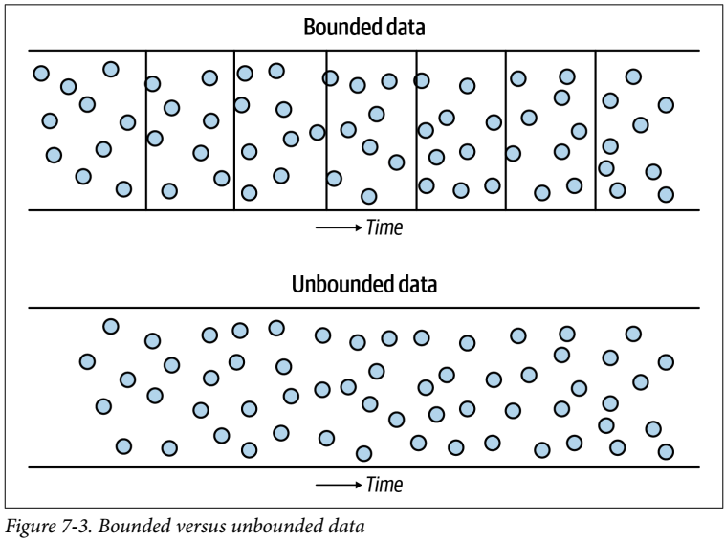
What is NOT a streaming data?
Batch data
“All data is unbounded until it’s bounded” (irrespective of whether they are generated continuously or sporadically).
Boundaries are created for convenience. Such bounded units of data are called batches.
E.g., a TODO list. The TODO items appear in our mind as an unbounded stream of thoughts. Then we write them on a piece of paper which is bounded.

Slide 6
Streaming data is ‘ingested’ in (near) real-time
Data ingestion is the process of moving data from one application to another application. For example, moving a live stream data from YouTube to the Google Cloud storage.
Data ingestion can be performed at different frequencies:
- Streaming data is ingested as soon as it arrives. - Sometimes data is ingested in micro-batches (e.g., once a minute). - On the other hand, data batches are usually ingested at longer time intervals (e.g., once a day).

Slide 7
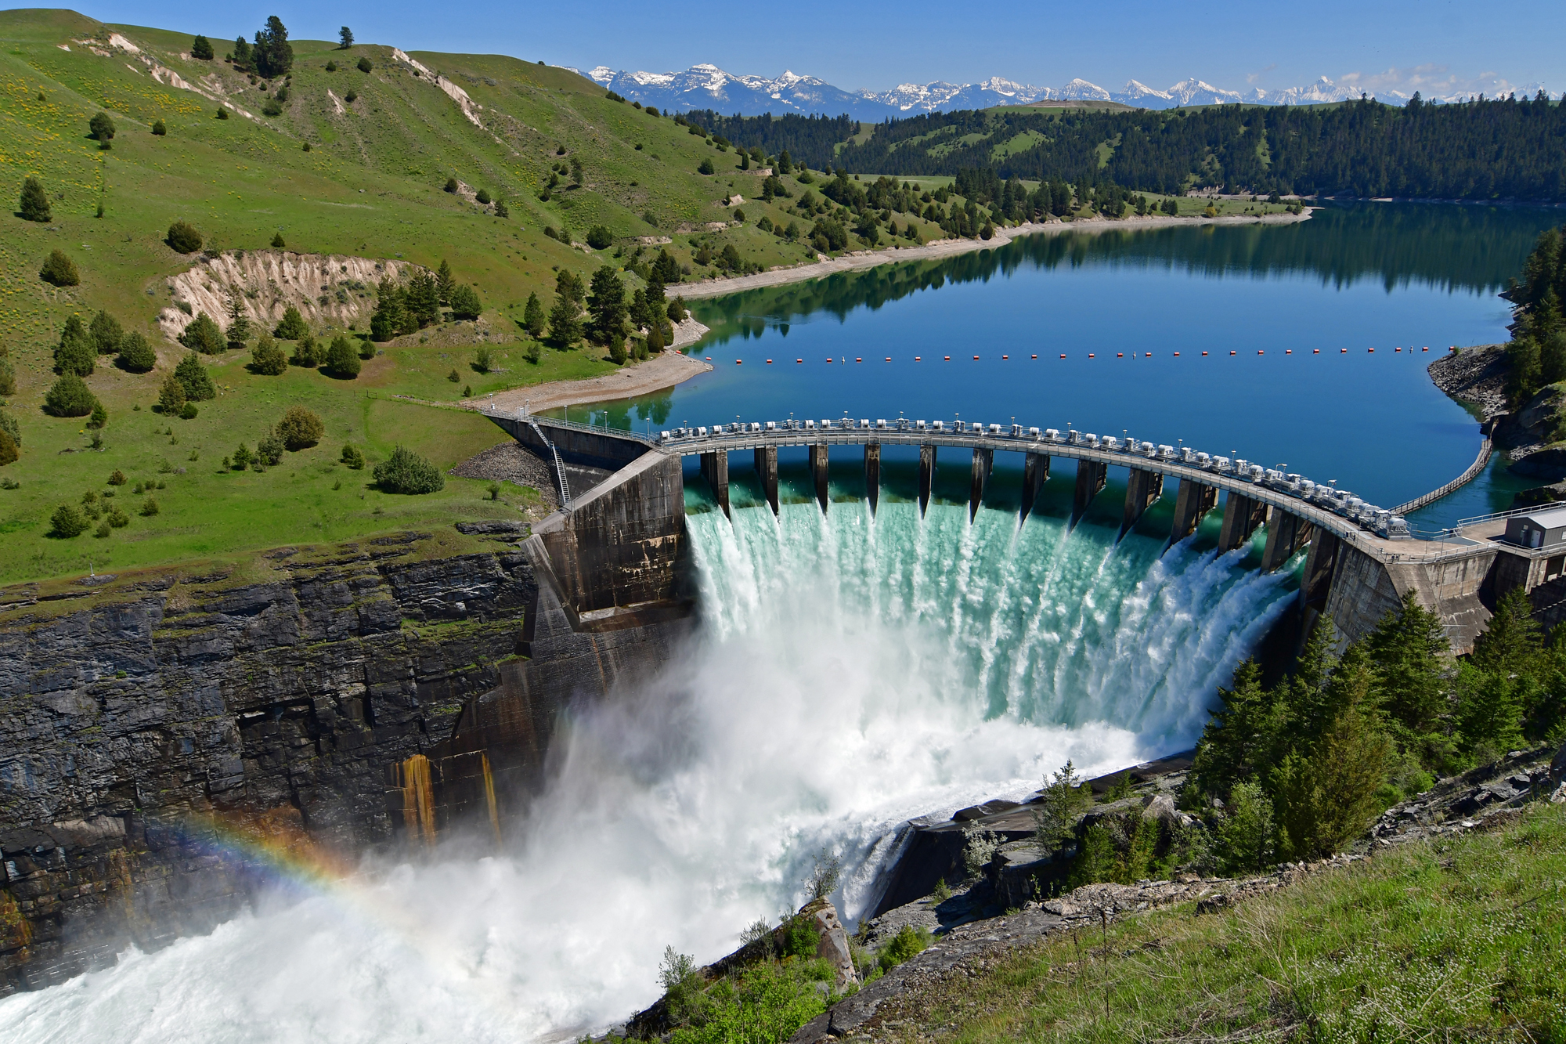
What is a data pipeline?
Data is like water.
Once generated at the source, it flows like a stream.
Sometimes we put dams to consume it in batches.

Slide 8
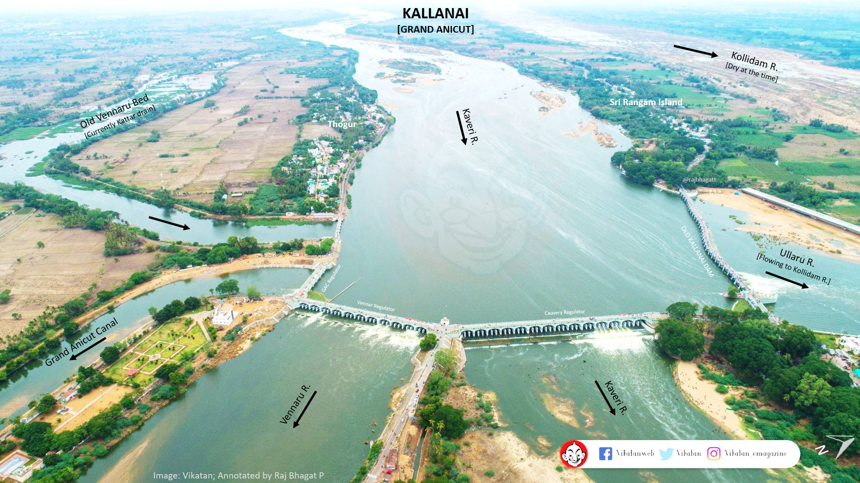
What is a data pipeline? (contd.)
Sometimes we split it and divert it to serve different applications.
The Kallanai Dam on the Kaveri river in Tamil Nadu. Constructed by King Karikala Chola in 150 AD.

Slide 9
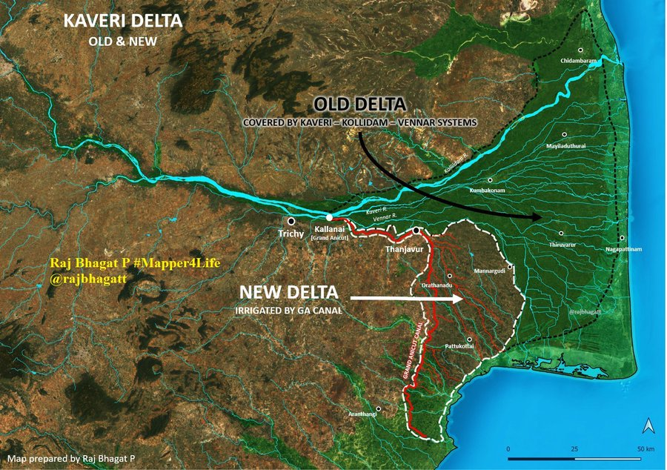
What is a data pipeline? (contd.)
Applications such as feeding a lot of people.
Natural course of the Kaveri
All these people would never have water otherwise.

Slide 10
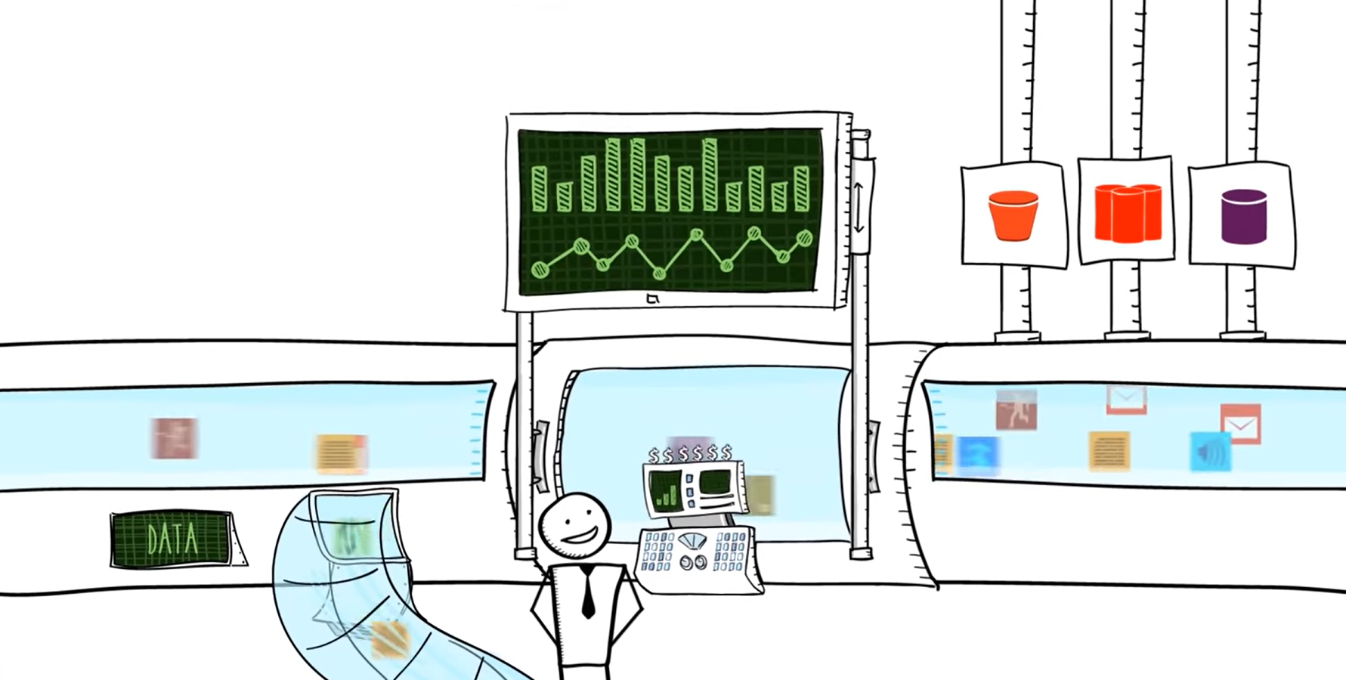
What is a data pipeline? (contd.)
Similarly, we channelize data into multiple applications.
(Dynamic) Dashboards
Data consuming applications
Sometimes, we combine data from multiple sources.
Data Engineer

Slide 11

Example of a traditional data pipeline: Old-day financial trading floor
Data source
Data stream processor
Data warehouse
A GUI software installed on on-premise desktop computers of the company. Employees are constantly making new trades.
A software ingesting and processing (extracting-transforming-loading) transactional trading data
A software that stores the data into domain-specific warehouses and produces domain-specific business intelligence reports at the end of every day.

Slide 12
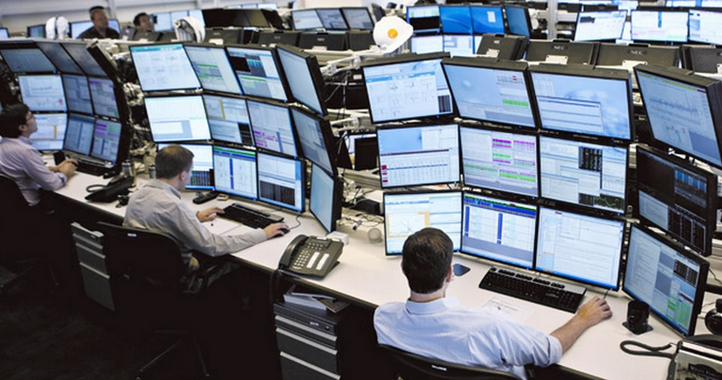


Example of a modern data pipeline: Modern-day financial trading floor
Enterprise trading software, high-frequency trading supercomputers, mobile trading apps
Cloud
A software ingesting data from hundreds of sources
Real-time monitoring
Data sources
Data stream processor
Data lakehouse
Data analytics
ML model 1
Order execution service
ML model 2

Slide 13
References
Section 8.3 ‘In-Memory Analytics’, P. RAJ, A. RAMAN, D. NAGARAJ, S. DUGGIRALA (2015), High-Performance Big-Data Analytics: Computing Systems and Approaches, Springer, 1st Edition.
Chapter 11 ‘Stream Processing’, M. KLEPPMANN (2017), Designing Data-Intensive Applications The Big Ideas Behind Reliable, Scalable, and Maintainable Systems, O’Reilly.
Chapter 7 ‘Ingestion’, J. Reis, M. Housley (2022), Fundamentals of Data Engineering, O'Reilly Media, Inc.,ISBN: 9781098108304

Slide 14
Thank you

